Slide 1

Reinforcement Learning
111061590
林學謙

Slide 2
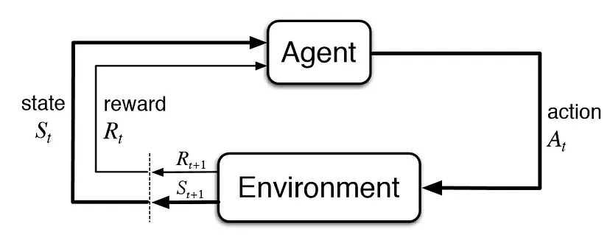
Reinforcement Learning

Slide 3
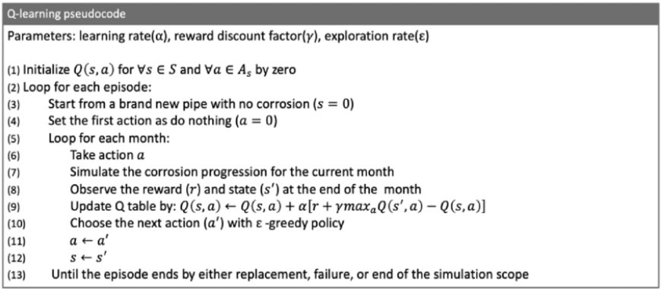
Pseudocode for Q-learning algorithm

Slide 4
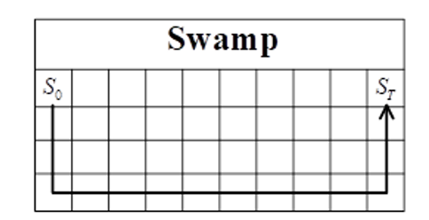
Environment

Slide 5
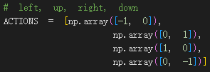
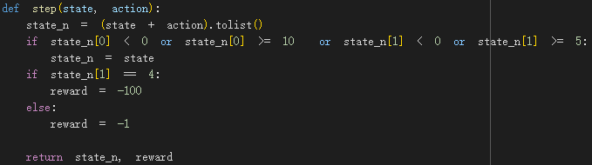
Define function

Slide 6
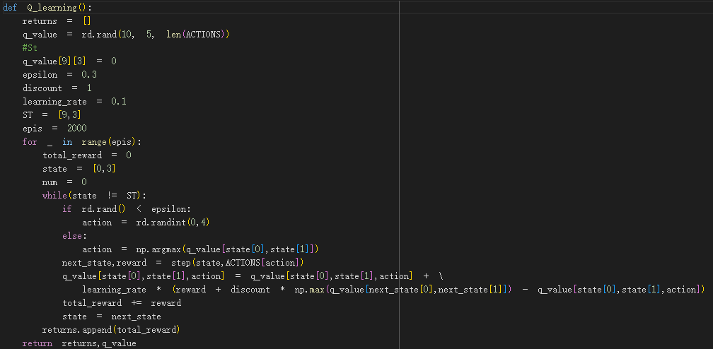
Define function

Slide 7
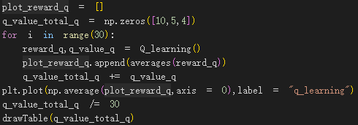
Main function

Slide 8
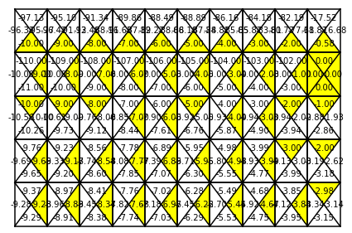
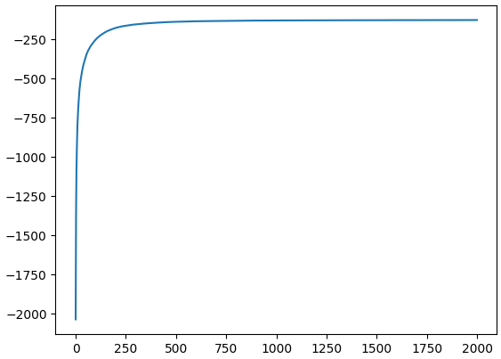
Result

Slide 9
Reference
https://www.researchgate.net/figure/Pseudocode-for-the-implemented-Q-learning-algorithm_fig4_344634163

